Slide 1




creative
PORTFOLIO
BY : AKASH S
REG NO : 24BSAI106

Slide 2
STUDENT NAME : AKASH S
REGISTER NO : 24BSAI106
NMID : CA938356E64499E81C84264D8E0DE75C
DEPARTMENT : B.SC .ARTIFICIAL INTELLIGENCE AND MACHIN LEARNING
COLLEGE : SRI KRISHNA ADITHYA COLLEGE OF ARTS AND SCIENCE
UNIVERSITY : BHARATHIYAR UNIVERSITY

Slide 3
PROBLEM STATEMENT
PROJECT OVERVIEW
END USERS
TOOLS AND TECHNOLOGIES
PORTFOLIO DESIGN AND LAYOUT
FEATURES AND FUNCTIONALITY
RESULTS AND SCREENSHOTS
CONCLUSION
GITHUB LINK
AGENDA

Slide 4
PROBLEM STATEMENT
BUILD A RESPONSIVE PERSONAL PORTFOLIO WEBSITE TITLED MY PORTFOLIO TO SHOWCASE MY PROFILE, PROJECTS AND CONTACT DETAILS.
PROVIDE A SIMPLE, PROFESSIONAL ONLINE RESUME AND PROJECT SHOWCASE FOR INTERNSHIPS AND INTERVIEWS.

Slide 5
PROJECT OVERVIEW
SINGLE-PAGE RESPONSIVE SITE USING HTML, CSS, JAVASCRIPT.
SECTIONS: HEADER (HELLO + INTRO + VIEW MY WORK), CENTERED ABOUT ME (PROFILE PHOTO + AI/ML STUDENT LINES), PROJECTS (3 CARDS), CONTACT FORM (PREFILLED), FOOTER.

Slide 6
END USERS
RECRUITERS & EMPLOYERS — QUICKLY REVIEW PROFILE AND PROJECTS.
PROJECT GUIDES & FACULTY — ASSESS ACADEMIC WORK.
PEERS & COLLABORATORS — LEARN ABOUT SKILLS AND CONTACT INFO.
SELF — DIGITAL RESUME FOR APPLICATIONS AND INTERVIEWS.

Slide 7
TOOLS AND TECHNIQUES
HTML5 — PAGE STRUCTURE
CSS3 — RESPONSIVE LAYOUT & STYLING
JAVASCRIPT — SMOOTH SCROLL, FORM VALIDATION & FOOTER YEAR
CODEPEN — RAPID DEVELOPMENT AND LIVE PREVIEW
IMAGE HOSTING (I.IBB.CO) — PROFILE PICTURE

Slide 8
PORTFOLIO DESIGN AND LAYOUT
CLEAN HERO HEADER WITH TITLE AND VIEW MY WORK BUTTON.
CENTERED ABOUT ME WITH ROUND PROFILE PHOTO AND TWO-LINE AI/ML STUDENT DESCRIPTION.
PROJECTS SECTION WITH THREE HORIZONTAL CARDS: ONLINE VOTING SYSTEM, MY PORTFOLIO, STRESS MANAGEMENT SENSOR.
CONTACT SECTION: VERTICAL SINGLE-FIELD INPUTS (NAME, EMAIL, PHONE) AND SEND BUTTON.
FOOTER WITH CURRENT YEAR.

Slide 9
FEATURES AND FUNCTIONALITY
RESPONSIVE DESIGN (DESKTOP & MOBILE).
SMOOTH SCROLL NAVIGATION TO PROJECTS.
PRE-FILLED CONTACT FORM FIELDS (NAME: MUGESH S; EMAIL & PHONE PROVIDED).
CLIENT-SIDE VALIDATION AND DEMO SUBMISSION.
LIGHTWEIGHT, CLEAN, AND EASY TO EXTEND.

Slide 10
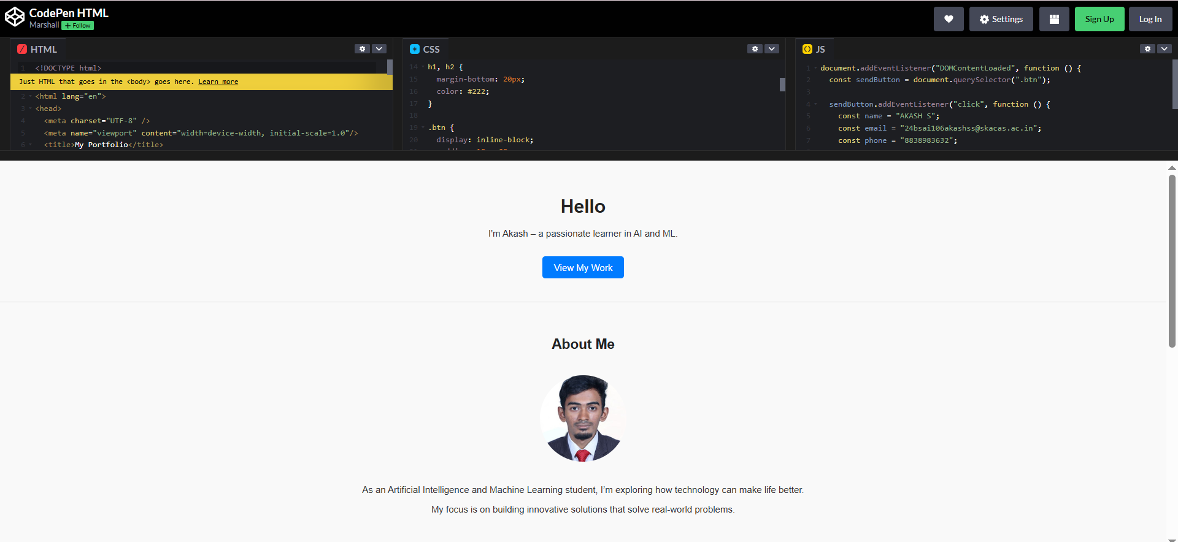
RESULTS AND SCREENSHOTS

Slide 11
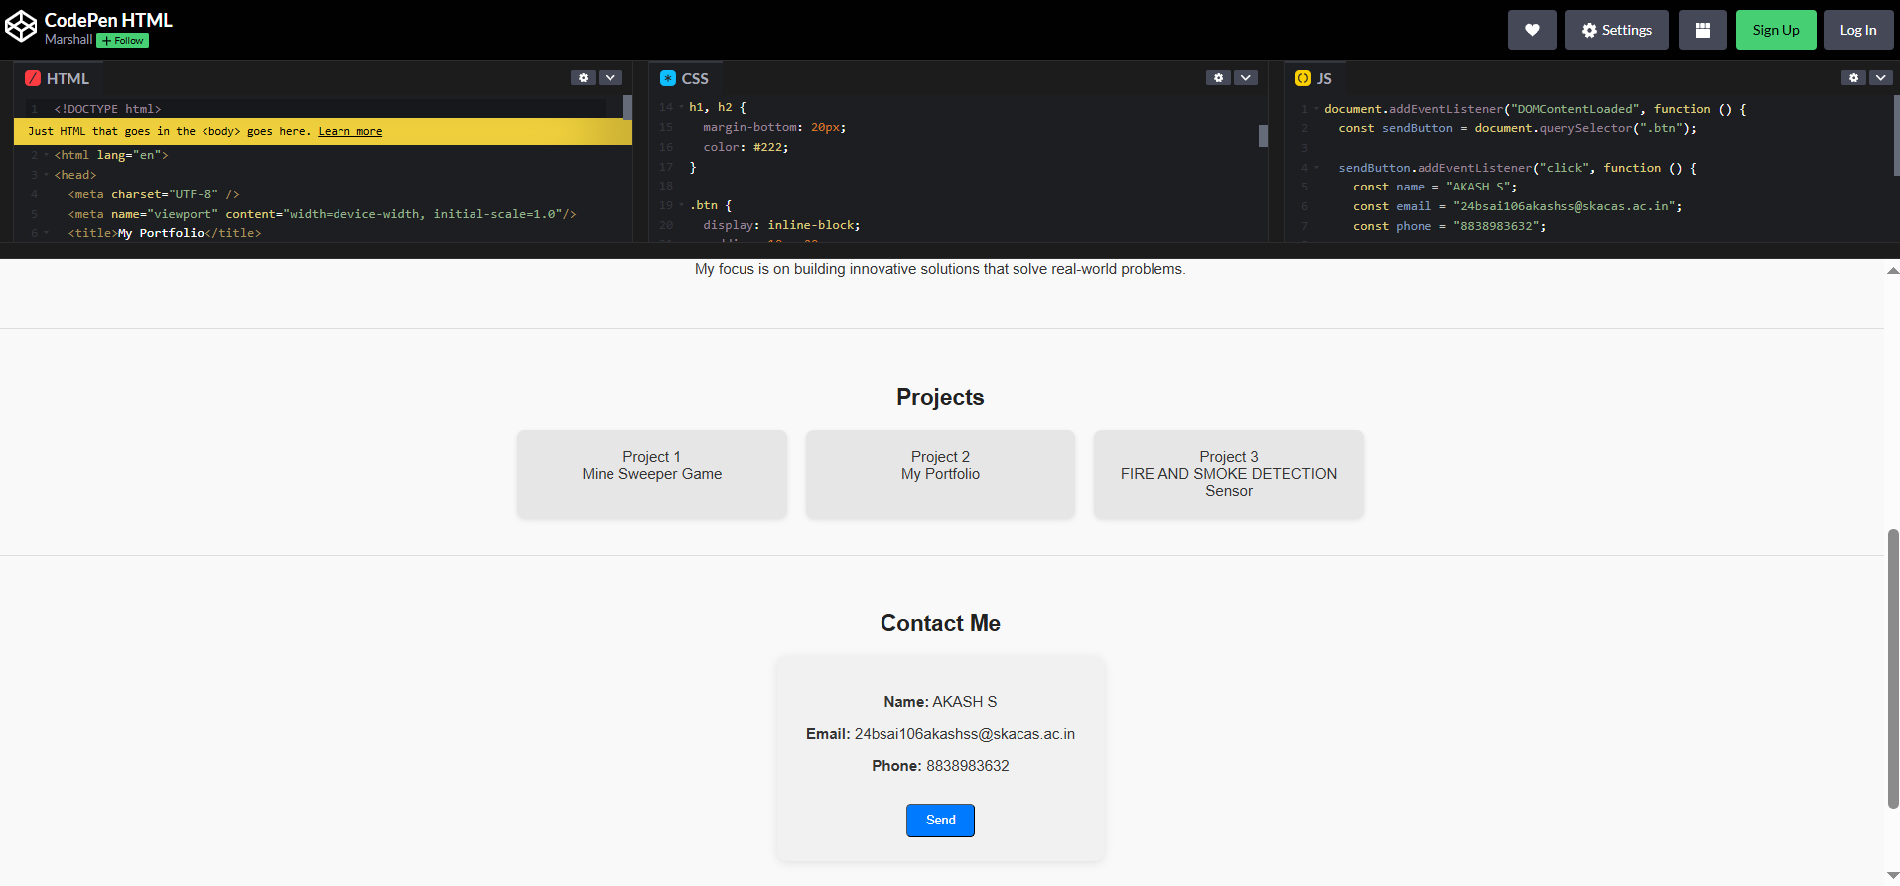
RESULTS AND SCREENSHOTS

Slide 12
CONCLUSION
COMPLETED A PROFESSIONAL PORTFOLIO WEBSITE THAT HIGHLIGHTS PROFILE AND PROJECTS.
NEXT STEPS: ADD PROJECT PAGES OR LIVE DEMOS, CONNECT A BACKEND OR EMAIL SERVICE TO RECEIVE MESSAGES, ADD GITHUB & LINKEDIN LINKS.

Slide 13
THANK YOU !!

